Slide 1
Tulare Local Health Care District FYE June 30, 2020 Operating Budget August 28, 2019
1

Slide 2
Agenda
FYE June 30, 2020 Operating Budget
FYE June 30, 2020 Statement of Cash Flows Budget
Summary of Services
Financials Results
Financial Projection Assumptions
2

Slide 3
FYE June 30, 2020 - Objectives
To assist the Tulare Local Health Care District (“TLHCD”) Board and Management to establish an Operating Budget that is consistent with its ability to fund on-going TLHCD operations, pay Chapter 9 commitments for the current fiscal year, and to be positioned to continue to support its ongoing obligations.
Project TLHCD income and expenses and related benefits.
Provide projections to support TLHCD’s short and long term cash flow requirements for current operations and debt service obligations.
3

Slide 4
FYE June 30, 2020 - Summary Analysis: History
The FYE 6/30/18 audited financial statements and corresponding audit grouping schedule were the starting basis for the projected budgets.
Actual revenues and expenses for the eight months ending February 28, 2019 formed the basis for projecting TLHCD on-going future operations for the balance of FYE 2019 & FYE 2020.
Incorporates various updates based on the past few months actual experience, along with adjustments based on anticipated changes in TLHCD operations during 2020.
Includes “carry over” from FYE 6/30/19, i.e., certain capital expenditures, full use of the City Line of Credit, and various transitional expenditures have been delayed to FYE 2020. These changes support (and do not alter) the overall 10 year plan. The FYE 2020 Budget compensates for delays in the FYE 2019 activities, and as of 6/30/2020, the cash position of TLHCD will be closely aligned with the Chapter 9 Plan projections.
Includes funds required to pay current-year obligations related to Chapter 9 claims commitments.
4

Slide 5
Financial Results
5

Slide 6
FYE June 30, 2020 – Summary of Analysis: Key Assumptions, Findings and Results
Key Assumptions:
Adventist Health (AH) lease income commences October 1, 2019, and all lease income will be applied against the outstanding Line of Credit (LOC) throughout the 2020 fiscal year.
Adventist Health will fund necessary capital expenditures during 2020, and these fundings will be added to the TLHCD LOC with AH.
The City of Tulare line of credit will be repaid in accordance with the loan terms, i.e., interest only for 2020, with 6-month interest payments due July 31, 2019 and January 31, 2020.
6

Slide 7
FYE June 30, 2020 – Summary of Analysis: Key Assumptions, Findings and Results (Continued)
Key Assumptions:
Revenue Bond Reserve funds will continue to be replenished in FYE 2020 in accordance with the Bond Indenture and Bond Supplement over a 2-year period ending in fiscal year 2021.
Surplus equipment and certain assets and properties are sold for approximately $3.0 million
Litigation and Avoidance recoveries are not projected to be fully received until fiscal year 2021.
Capital Expenditures to comply with California seismic regulations in 2020 as preparation for 2030 compliance are included.
Basic maintenance of the TLHCD facilities is included.
Inclusion of a fiscally prudent cash reserve.
7

Slide 8
FYE June 30, 2020 – Tulare Local Health Care District – Operating Statement
8

Slide 9
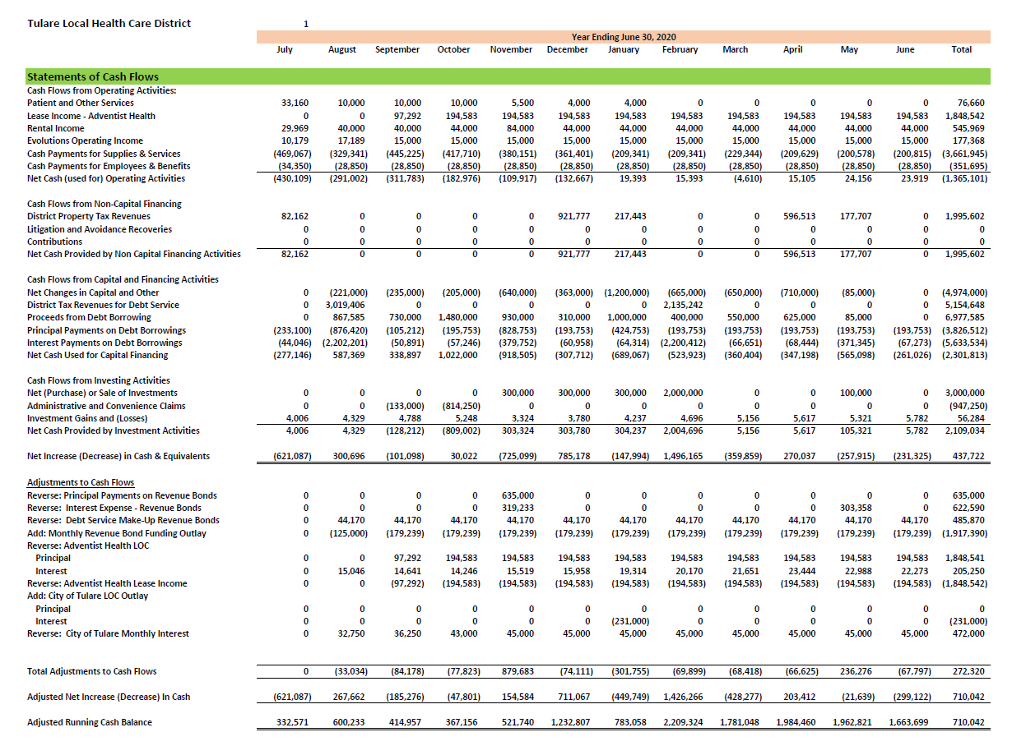
FYE June 30, 2020 – Tulare Local Health Care District – Statement of Cash Flows
9

Slide 10
Financial Projection Assumptions
Tulare Local Health Care District
10

Slide 11
FYE June 30, 2020 – Footnotes to Revenue Assumptions
General Obligation Bond (GO) tax revenue is equal to the interest and principal on the Series A, B-1 and B-2 bonds.
Other property tax revenue is based on the actual fiscal 2019 tax revenues.
Assumes the TLHCD capital expenditures in FYE 2020 will be funded through the Adventist Health Line of Credit.
Adventist Health lease income assumes the lease began March 15, 2019. The first year lease payment commences September 15, 2019 with an annual amount of $2,335,000 over the following 12 months.
11

Slide 12
FYE June 30, 2020 – Footnotes to Slide 8 Revenue Assumptions
Property Rental income is based on the current rental agreements for the TLHCD properties.
Evolutions net income is based on the estimated actual for 2019 and is increased as the number of memberships expand.
Litigation recoveries and Avoidance claims are estimated to begin in the next FYE June 30, 2021.
The Line of Credit with the City of Tulare was not fully used in FYE 2019, but will need to be accessed fully in FYE 2020.
12

Slide 13
FYE June 30, 2020 – Footnotes to Revenue Assumptions
Revenue associated with the sale of excess equipment and assets is estimated at $3,000,000 for FYE 2020 including:
Evolutions adjacent land
Properties, Surplus Equipment & Business Lines
Note: The sale of certain real properties has been delayed from September 2019 to February 2020.
Interest income is projected at 3.0 percent of the restricted funds associated with the 2007 Revenue Bonds.
13

Slide 14
FYE June 30, 2020 – Footnotes to Slide 8 (Operating Expense Assumptions)
Salaries and Benefits
TLHCD Administration – 3 FTE’s (CEO, Controller and Admin. Asst.)
Benefits – Projected at 35% of Salary and Wages
Insurance – Estimated based on 2019 premiums inflated at 3.0 percent per annum.
Utilities – Actual 2019 expenses inflated at 1.85 percent per annum.
Legal – Includes estimates for TLHCD General, Defense, Bankruptcy, Bond and Trustee attorney fees.
14

Slide 15
FYE June 30, 2020 – Footnotes to Slide 8 (Operating Expense Assumptions)
Consulting and Purchased Services – Includes estimates for Administrative and Accounting support until full transition to TLHCD employees, and in accordance with the Transition Services Agreement with Adventist Health. Also includes estimates for IT, Security and Other contracted services.
Leases and Rentals – Based on actual 2019 expense inflated at 2.0 percent per annum. A small reduction was anticipated in mid year 2020 to account for the reduction in some of the storage after the sale of surplus equipment. Also includes projected property management fees.
Supplies and Other – Based on actual 2019 expense inflated at 1.0 percent per annum. The majority of these expenses include repairs and maintenance, yard upkeep and gardening for TLHCD properties, IT and computer services, office supplies and Board support expense.
15

Slide 16
FYE June 30, 2020 – Footnotes to Slide 8 (Nonoperating Expense Assumptions)
Capital Expenditures - Fiscal year 2020 is based on estimated projects to meet 2020 seismic requirements necessary to achieve 2030 status. Payments for chillers along with the installation costs have been delayed from FYE 2019 and added to this budget.
16

Slide 17
FYE June 30, 2020 – Footnotes to Slide 8 - Chapter 9 Claims
Chapter 9 Claims:
Class 1 through Class 6 claims include interest and principal on the TLHCD long-term debt in accordance with the Chapter 9 Plan of Adjustment.
Revenue Bond Reserve Funds are replenished over a two year period ending in fiscal year ending 2021.
Class 10 consists of general unsecured creditors in the amount of $5,000 or less who elect to receive 50% of the allowed claim within 60 days of confirmation.” Class 10 consists of all allowed unsecured claims filed for $5,000 or less. This assumes the amount to be distributed will be less than $25,000.
17

Slide 18
FYE June 30, 2020 – Footnotes to Slide 8 – Chapter 9 Claims and Cash Reserve
Class 8 Claims are not included in the 2020 budget, but will be paid in later years in accordance with the Bankruptcy Chapter 9 Plan of Adjustment.
The goal of the Cash Reserves reflects disbursements from revenues to a cash reserve account of approximately 180 days of expenses. TLHCD needs to maintain a reserve as a matter of prudent financial management, however, this reserve will not be fully achievable during this coming fiscal year. (The 180 day reserve is less than what other financially sound districts typically maintain.)
18

